Slide 1


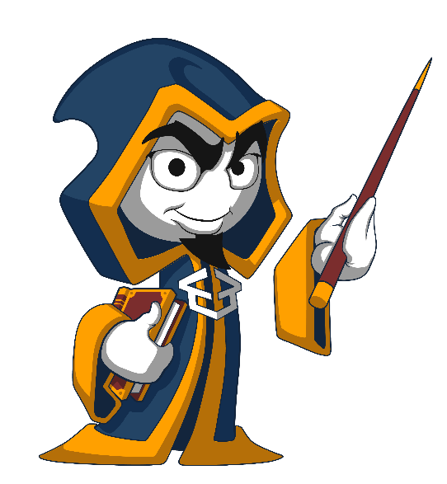
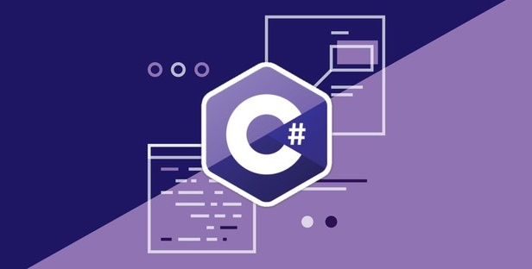
Programming Fundamentals
Course Introduction: Curriculum, Trainers, Exams, Schedule, Resources
Programming Fundamentals
SoftUni Team
Technical Trainers
Software University
http://softuni.bg

Slide 2
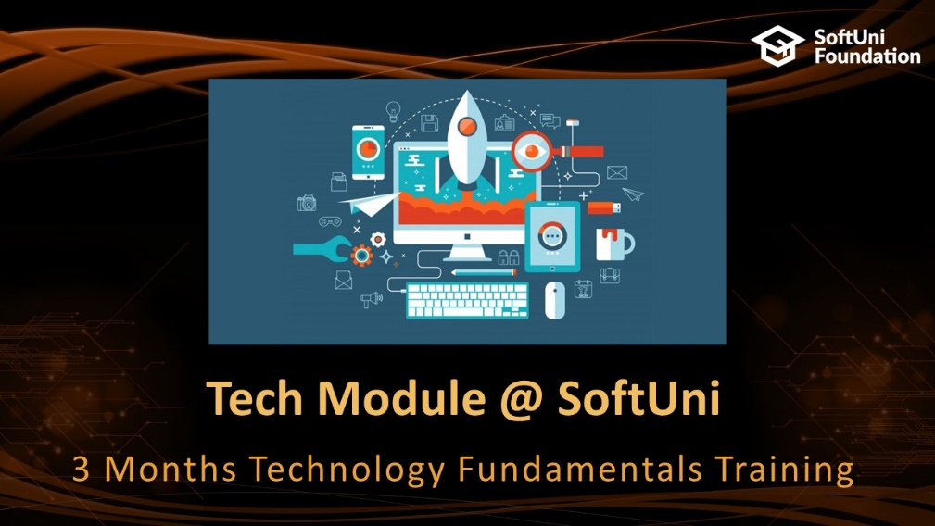





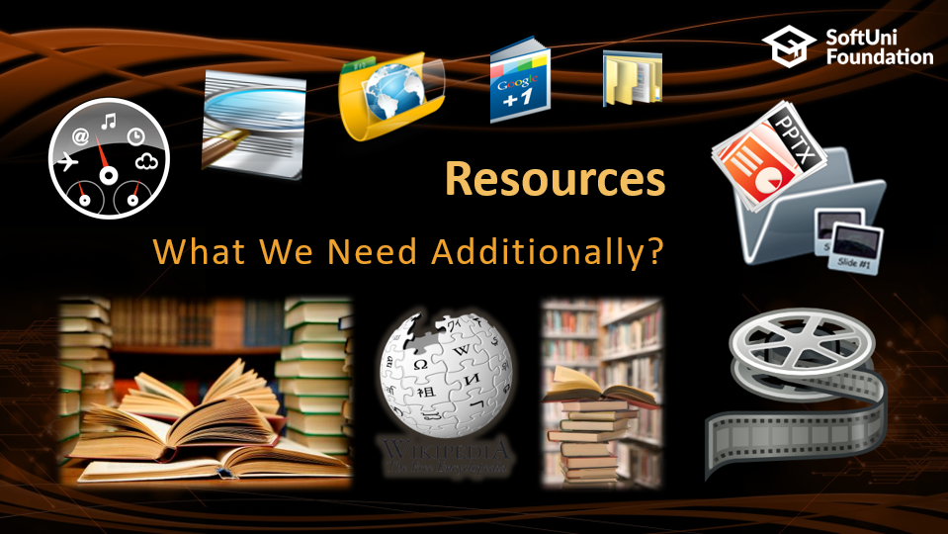
Table of Contents

Slide 3






SoftUni Diamond Partners

Slide 4






SoftUni Diamond Partners

Slide 5
Questions
sli.do #tech-softuni

Slide 6

Tech Module @ SoftUni
3 Months Technology Fundamentals Training

Slide 7
Tech Module: Goals
"Technology Fundamentals" Module @ SoftUni
4 times weekly, lots of live coding and exercises
Part I – Programming Fundamentals
Arrays, lists, dictionaries, collections, lambda and LINQ, objects, files, strings, regular expressions, …
Part II – Software Technologies
Get acquainted with the most popular technologies out today
HTML, PHP Web, JavaScript Web, Java Web, C# Web

Slide 8
Tech Module at SoftUni – Timeline
14-May-2018
2-July-2018
Aug-2018
Programming Fundamentals
6 credits
7 weeks x 4 times / week
Final exam: 1-July-2018
Software Technologies
12 credits
6 weeks x 5 times / week
Final exam: 12-August-2018
Re-Take Exams
TBA

Slide 9
Professions @ SoftUni
Programming Basics
Java
Fund.
Java
DB
Java
Web
JS Core
Tech Module
C#
Fund.
C#
DB
C#
Web
JS Core
Programming Fundamentals
JS Core
MEAN
Stack
Front End
Software Technologies
PHP
Web
Front End
JS Core
https://softuni.bg/curriculum
https://softuni.bg/trainings/courses
https://softuni.bg/users/profile/curriculum

Slide 10

Programming Fundamentals
Course Objectives & Program

Slide 11

Programming Fundamentals – Course Program
Course Introduction – Course Program, Trainers, Exams, Resources
C# Intro: Basic Syntax, Using Visual Studio
C# Intro: Conditional Statements and Loops
Data Types – Numeral Types and Type Conversion
Methods and Debugging – Finding and Fixing Bugs in Programs
Arrays – Simple Array Processing
Lists – Processing Variable Length Sequences

Slide 12
Programming Fundamentals – Course Program (2)
Dictionaries, Lambda and LINQ – Collections and Queries
Objects and Simple Classes – Use / Define Objects and Classes
Strings and Text Processing – Processing and Manipulating Text
Regular Expressions – Modern Text Processing
Files, Directories, Exceptions – Working With the File System and Handling Exceptions
Git and GitHub – Working with Git and GitHub
Exam Preparation – Practical Exam Problems (3 times)
Practical Exam – 4 Problems for 6 Hours

Slide 13

The Trainers Team

Slide 14
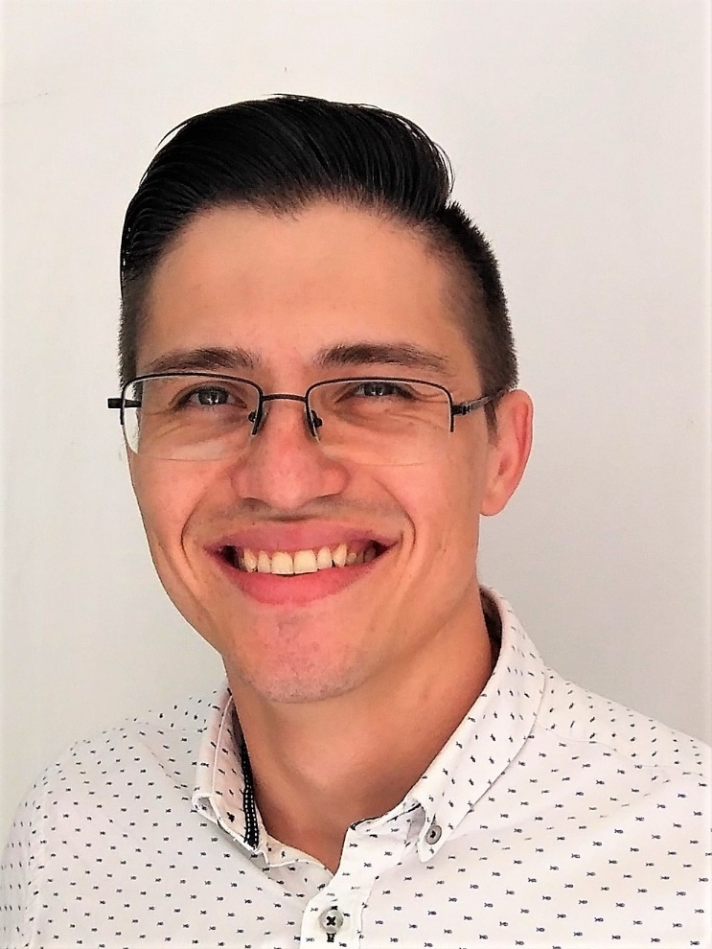
Trainers Team – Group 1
Alen Paunov
Technical Trainer @ SoftUni
Passionate about C# and GameDevelopment with Unity
Interested in Blockchain and Artificial Intelligence

Slide 15
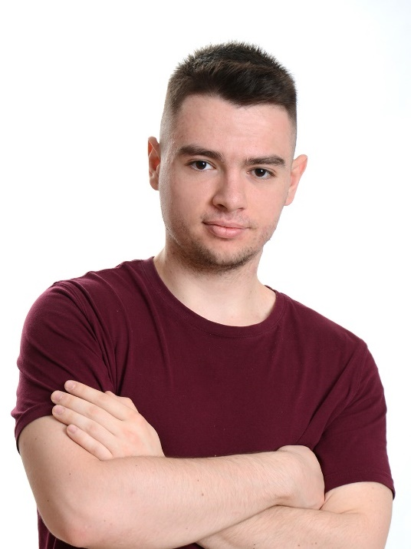
Trainers Team – Group 1
Atanas Atanasov
Technical Trainer @ SoftUni
Highly interested in C#
Interested in different technologies such as Java and JavaScript

Slide 16
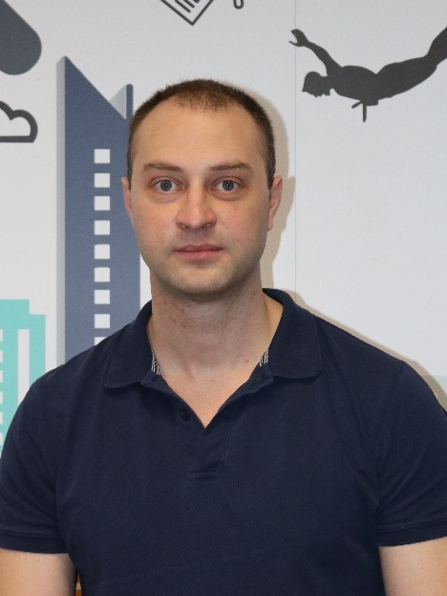
Trainers Team – Group 2
Mihail Velikov
Technical Trainer @ SoftUni
Deep into Java
Interested in C#, JavaScript and PHP web development

Slide 17
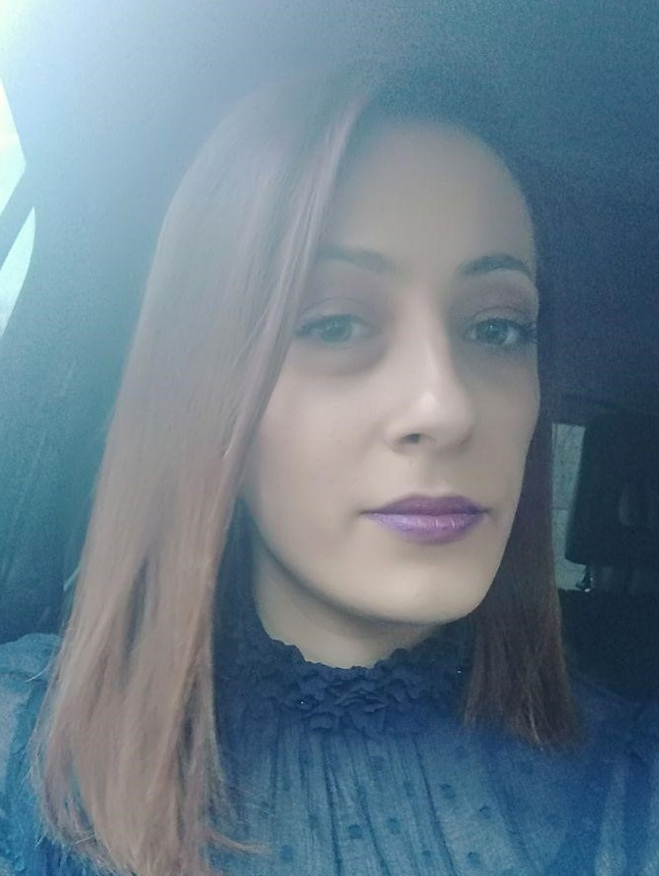
Trainers Team – Group 2
Veronika Nacheva
Technical Trainer @ SoftUni
Fiery Enthusiasm of Java
Interested in C# and Game Development with Unity

Slide 18

Programming Fundamentals: More Details
Duration, Languages, Technologies

Slide 19


Training Duration – Programming Fundamentals
Lessons: ~50 hours (onsite + videos)
Practical exercises (in class): ~60 hours
Exam preparation: 3*4 hours
Exam: 6 hours
Schedule: May –July 2018
Exam date: 01 July 2018

Slide 20



Why English?
Why the slides are in English?
English is the native language of the software engineers
Specific terminology should be in English
Translations are inaccurate and funny
Just learn English!
No excuses

Slide 21



Learn to Search in Internet & Find Solutions!
The course assignments require to search in Internet
This is an important part of the learning process
Some exercises intentionally have no hints
Learn to find solutions!
Software development includes everyday searching and learning
No excuses, just learn to study!
Developers learn new technologies, tools, languages every day!

Slide 22
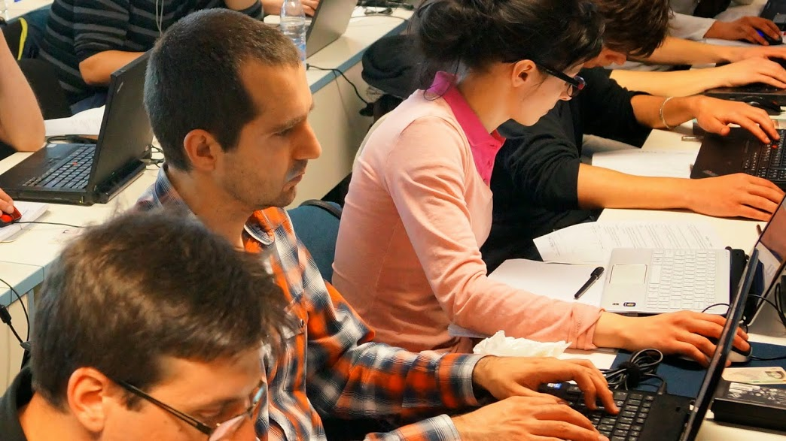

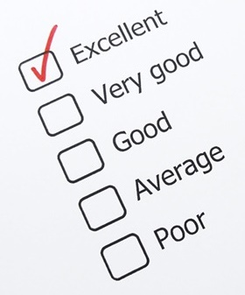
Programming Fundamentals
Evaluation Criteria

Slide 23


Scoring System for “Programming Fundamentals”
Exam – 90%
Homework (exercises) – 10%
Bonuses: up to 10%
Presence in class: 5% (onsite students only)
Forum activities

Slide 24
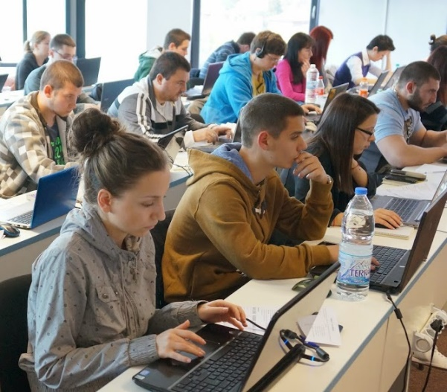

Programming Fundamentals Exam
Practical programming exam
4 practical problems for 6 hours
Simple arrays, lists, dictionaries, strings
Code in C# (Java, PHP, JS are also welcome)
Automated judge system
http://judge.softuni.bg
Solutions are evaluated for correctness only
Code quality is still not measured

Slide 25

Homework Assignments
Doing your homework is very important!
Programming can only be learned through a lot of practice!
You should write code every day!
Each lesson is followed by many exercises
Try to solve them in class
The rest are your homework
Homework assignments are due in 6 days after each lecture
Submission through our online judge system: judge.softuni.bg

Slide 26










Resources
What We Need Additionally?

Slide 27
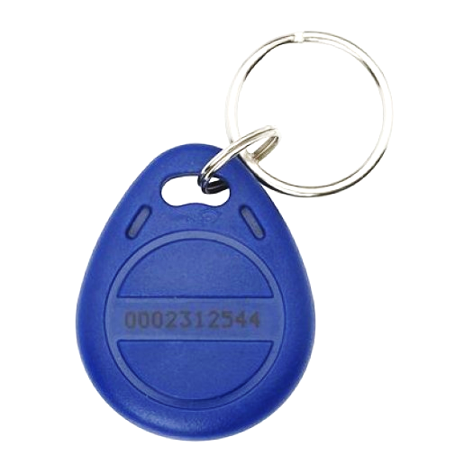
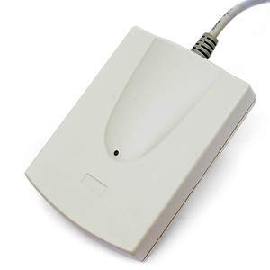
Your RFID Chip
Students can either
Take RFID chip from SoftUni
Or use their own chip / card
Register your chip number in your SoftUni profile: https://softuni.bg/users/profile/show
Check-in at the reception every time when you come
See your last visits in your profile: https://softuni.bg/users/profile/show

Slide 28



PF Course Web Site, Forum and FB Group
Official web site:
Official discussion forum:
Official Facebook group:
softuni.bg/courses/programming-fundamentals
softuni.bg/forum/categories/44/programming-fundamentals
fb.com/groups/SoftUniTechModuleMay2018

Slide 29

The Prog. Fundamentals Slides and Videos
All lecture slides, videos, homework assignments, projects and other resources are open content, available for free
Visit the course web site to access the course resources

Slide 30
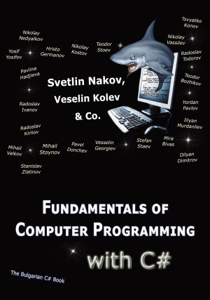

The Free C# Fundamentals Textbook
Partial textbook for the course:
"Fundamentals of Computer Programming with C#", by Svetlin Nakov & Co., 2013, ISBN 9789544007737
English and Bulgarian versions (as PDF, ePub, …)
Freely downloadable from: www.introprogramming.info
The C# Programming courses @ SoftUni.bg partially follows the book
Programming Fundamentals → chapters 2, 3, 7, 9, 11, 13, 14, 16, 18, 22

Slide 31
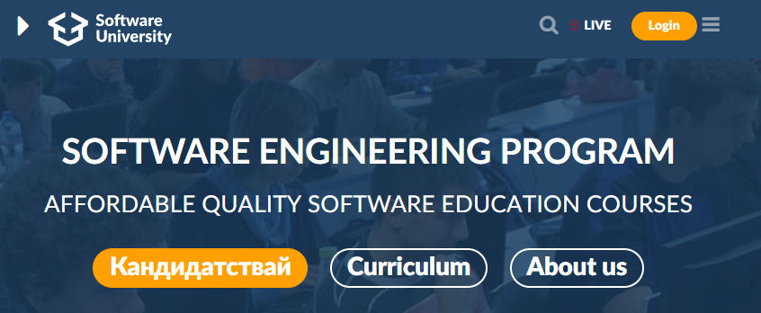
Software University Learning System (SULS)
Software University Learning System (SULS)
www.softuni.bg
Important resource for students
Homework submissions
Homework check-up
Exams and results
Reports about your progress
…

Slide 32


Required Software
Software needed for this course:
Microsoft Windows (Win 10 / 8.1 / Win8 / Win7) or Mac or Linux
Visual Studio Community 2017 (a free version of VS 2017)
Older versions are acceptable, but not recommended
Alternative: MonoDevelop (for Linux / old Windows)

Slide 33


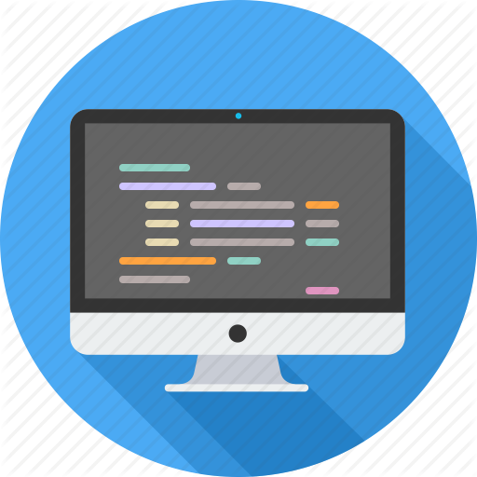

Summary
Training program
Data types, methods, debugging, arrays and lists, dictionaries, objects, strings and much more
Practical exam
4 problems for 6 hours
Learning resources
Slides, videos, software, books, forum

Slide 34










Programming Fundamentals – Course Overview
https://softuni.bg/courses/programming-fundamentals

Slide 35
License
This course (slides, examples, demos, videos, homework, etc.) is licensed under the "Creative Commons Attribution-NonCommercial-ShareAlike 4.0 International" license

Slide 36





Trainings @ Software University (SoftUni)
Software University – High-Quality Education, Profession and Job for Software Developers
softuni.bg
Software University Foundation
http://softuni.foundation/
Software University @ Facebook
facebook.com/SoftwareUniversity
Software University Forums
forum.softuni.bg

